Slide 1
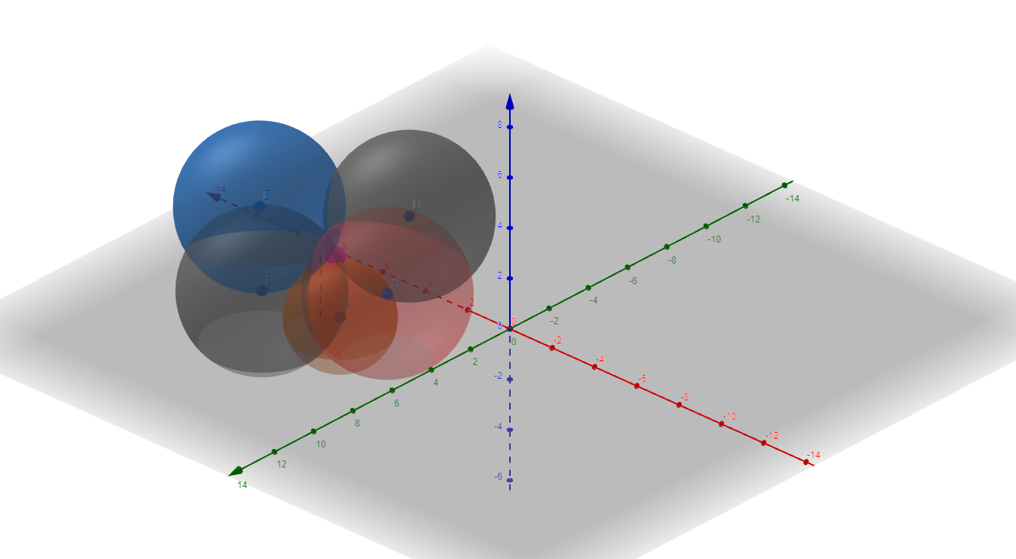
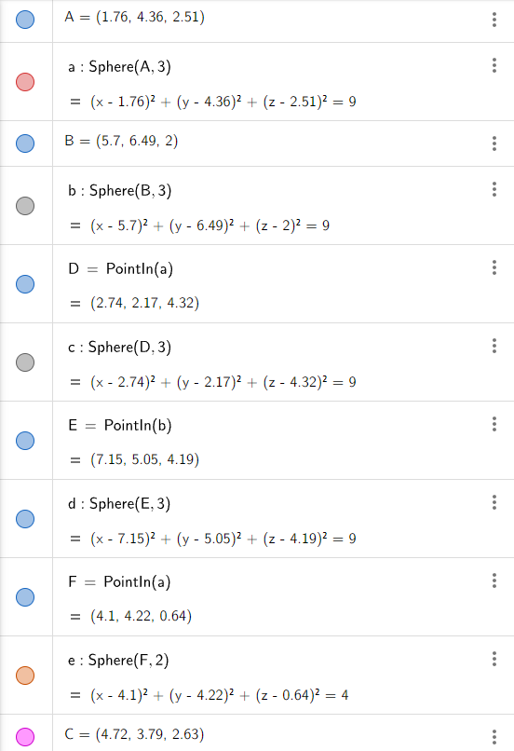
Input
Predicted Location
Output
Multilateration result: x = 4.718363032489757 , y = 3.7934353069676505 , z = 2.6330022903176085
https://www.geogebra.org/3d/jgx7urcu

